Slide 1
Developing Cultural Competency
Presented by: Jenny Chang

Slide 2
Outline
Introduction
The Impact of Culture
What is Cultural Competence?
What do you think?
Intercultural Development Continuum
Where am I?
Cultural Competency in Healthcare
Cultural Impacts in Clinical Care
Effective Communication
Family Dynamics
Summary
Potential Solutions

Slide 3
The Impact of Culture
“Our own culture is like water to a fish. It sustains us. We live and breath through it”
Tompenaars, F. and Hampden-Turner, C. (2005) Riding the Waves of Culture: Understanding Cultural Diversity in Business (Nicholas Brealey, UK)

Slide 4
What is Cultural Competence?
The capability to shift cultural perspectives and adapt behaviour to cultural commonality and difference in order to successfully accomplish cross-cultural goals.
Cultural competence is:
Developmental
Learned
Four components:
Cultural awareness
Sensitivity
Knowledge
Skills
Awareness
Sensitivity
Knowledge
Skills
Notes:
Cultural competence refers to an ability to communicate and interact effectively with people of different cultures. It is not just about knowing another person’s culture.
Competence involves the capacity to function effectively as an individual within the context of the cultural beliefs, behaviours and needs presented by in our case patients and their ethnic communities.
Awareness – Having the capacity for cultural self-assessment
Sensitivity – Becoming conscious of the microdynamics inherent in cultural interactions
Knowledge – Developing a knowledge base about other cultures
Skills – Reflecting competence in relationship
An culturally competent individual has the ability to…
Reflect intentionally about his or her own cultural identity
Adapt constructively to an unfamiliar cultural environment
Communicate effectively cross-culturally
Build relationships of mutual respect and trust across cultural boundaries Engage in cultural learning without pre-judgment or use of stereotypes
The capability to shift cultural perspectives and adapt behavior to cultural commonality and difference

Slide 5
What do you think?
A boss asks a subordinate to help him paint his house. The subordinate, who doesn’t feel like doing it, discusses the situation with a colleague.
Which option best reflects your own view?
The colleague argues: You don’t have to paint the house if you don’t feel like it. He is your boss at work. Outside he has little authority.”
The subordinate argues: “Despite the fact that I don’t feel like it, I will paint the house. He is my boss and you can’t ignore that outside work either.”

Slide 6
What do you think?
A boss asks a subordinate to help him paint his house. The subordinate, who doesn’t feel like doing it, discusses the situation with a colleague.
Which option best reflects your own view?
The colleague argues: You don’t have to paint the house if you don’t feel like it. He is your boss at work. Outside he has little authority.”
The subordinate argues: “Despite the fact that I don’t feel like it, I will paint the house. He is my boss and you can’t ignore that outside work either.”
Percentage of respondents who believe you do not have to paint the house
32%
China
58%
Indonesia
63%
South Korea
66%
India
82%
U.S.
88%
UK
91%
Sweden

Slide 7
What do you think?
Individuals were asked to indicate whether they agree or disagree with the following statement?
“The respect a person gets in highly dependent on their family background.”
I agree
I disagree
Percentage of respondents who disagree
50%
Arab Cultures
Austria
57%
Thailand
India
Hong Kong
73%
Switzerland
South Korea
87%
Canada
USA
UK
94%
Denmark
Ireland
Norway

Slide 8
Intercultural Development Continuum
Denial
Polarization
Minimization
Acceptance
Adaptation
Disinterest
Avoidance
Defense
Reversal
Similarity
Universalism
Cognitive frame-shifting
Behavioral code-shifting
Mono-cultural
Mindset
Intercultural
Mindset
Modified from the Developmental Model of Intercultural Sensitivity (DMIS), M. Bennett, 1986
Source: Mitchell R. Hammer, Ph.D.

Slide 9
Denial

Slide 10
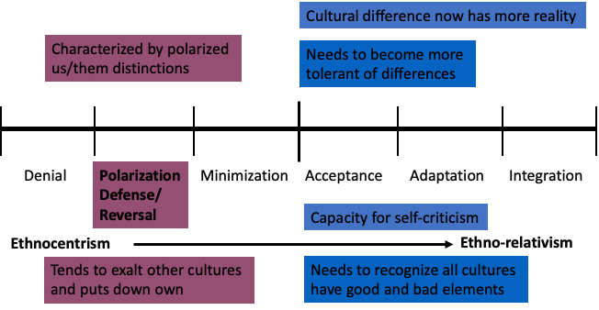
Polarization

Slide 11
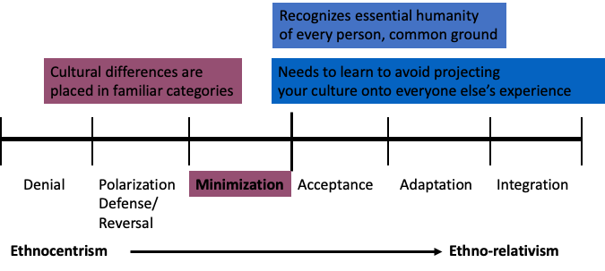
Minimization

Slide 12
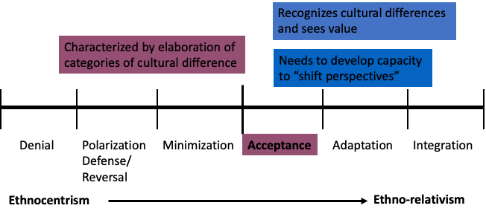
Acceptance

Slide 13
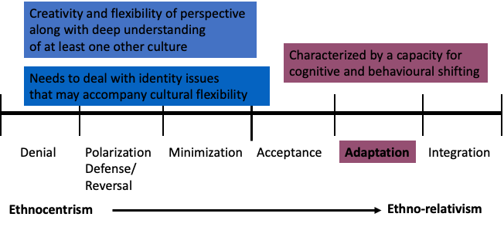
Adaptation

Slide 14
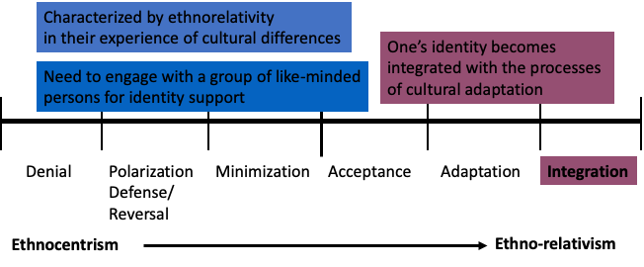
Integration

Slide 15
Where am I?
Able to identify areas of common concern with other cultures
Able to understand and appreciate other cultural perspectives
Able to shift and adapt to another culture’s worldview
No experience of cultural differences
Able to distinguish cultural differences
Able to think and act from multiple perspectives
Denial
Integration
Pizza Hut works for me
I love that Indian restaurant downtown!
Our Indian neighbours are good people
On our last holiday we spent 3 weeks in India!
We lived in India for 3 years!
We live in an Indian community in New Zealand

Slide 16
Cultural Competency in Health Care
Culture
One’s beliefs, rituals, customs, and practices that guide thinking
Cultural difference
Cultural competency
Honour and respect the beliefs, language, interpersonal behaviours
Explanatory Model
The belief system that people from a given culture have about what has caused their illness and what the illness does to them.
Patients’ beliefs about what will help cure them depend on their explanatory model
Social Factors
Environmental factors which affect how the family functions
Acculturation / Assimilation
The process of acquiring a second culture.
Assimilation is the process of replacing one’s first culture with a second culture
Notes:
Have you ever had this experience - you are talking with a patient about some care option and you just cannot come to an agreement. It seems so obvious to you what needs to be done; how come he/she can't see it? It just doesn't make sense. Yet, perhaps it does. People, especially those from different cultural backgrounds, often have very different ways of understanding illness, its consequences, and how best to treat it - a different explanatory model. By exploring the explanatory model of illness we can better understand our patients and families, in effect making sense, out of nonsense. The explanatory model can also be useful in interpreting the culture of Western medicine to others who find our explanatory model peculiar. The Western medical model is mechanistic in nature; the body is a machine, prone to malfunctions, requiring tune-ups or occasional part replacement. The patient's obligation is to present this 'machine' to the 'mechanic' (physician) who will make repairs. This explanatory model differs greatly from other models that view illness more as an imbalance of forces (ex: Chinese - yin-yang, Hispanic- hot-cold) or as being influenced by unseen forces such as spirits, demons or curses. Gaining a better understanding of another's explanatory model will not in and of itself resolve conflicts in end-of-life care. However, a foundation can be established for negotiating a course of care that is acceptable within both the Western medical model and the model of the patient and family. Negotiation and compromise are critical; trying to convince the other that your explanatory model is correct, and theirs is wrong, will not work and will only worsen your relationship.

Slide 17
Culture Impacts on Clinical Care
3 cultures that influence outcome
Patient’s (own cultural beliefs, values and behaviours of personal life experiences)
Clinicians
Culture of Medicine (Patient autonomy, value placed on science)
Patient Centred
Assess cultural issues
Explore the meaning of the illness
Determine the social context
Engage negotiation

Slide 18
Effective Communication
Improved patient satisfaction, adherence and health outcomes
Telephone Survey in the USA (19%)
Had trouble understanding their doctor, felt their doctor did not listen and felt there were questions they could not ask
16% whites, 23% African Americans, 33% Hispanics, 27% Asian Americans

Slide 19
Family Dynamics
We take for granted that patients wish to make decisions for their own healthcare
Family members and others may be very involved
The patient and family ay look to a specific authority figure
They may wish to exclude the patient from the decision – undue stress
Need to negotiate carefully

Slide 20
Summary
Being inter-culturally sensitive
Developing it requires systematic and intentional training for a processing of experiences.
Lack of orientation and processing may produce little to no increase or has the potential to undermine the pre-experience developmental orientation.
Cultural differences when misunderstood can lead to lack of trust and engagement
Attention to cross cultural issues
Use explanatory models- understand patient’s perspective
Patient based approach – assess core cross cultural issues, patient’s explanatory model and understanding the social context and negotiate for a mutually acceptable approach

Slide 21
Potential Solutions
Develop individual multi-cultural awareness
Introduce health promoters
Multi-lingual information packages
Cultural support and interest groups
Asian heath champions: www.acma.org.nz
Participate in GLMS CME Program

Slide 22
Thank You!
&
Questions?

